Slide 1
Sources of Finance
MANAGING FINANCIAL RESOURCES AND DECISIONS

Slide 2
What is Finance?
Who needs money?
  Every one? you?
  Can you or a business survive without cash? Why?
So what is Finance?
  First, how to have money

Slide 3
Personal finance
Where does money for individuals (personal finance) come from:
  Our own money in pocket
  Borrows: from friends or credit cards
  Received from Government if entitled to some benefits
  Earned by doing something or sales of products and services

Slide 4
Business finance
Business finance: a business has the same source of money for individuals
  Its own money
  Borrows: from friends, colleagues, banks and lending institutions
  Received from Government grants. Eg. new in deprived sectors
  Earned by sales of products and services
  From venture capitalists (seeking profit for spare funds)
  From private individuals (Business Angels – often seen in entertainment sector)
  Private companies
  Microloans

Slide 5
To obtain funding for a business project
Determine how much money is needed to start your company
Prove to your investor that your company requires the predetermined amount of money
Offer incentives, interest, or collateral for the investor’s contribution
Make arrangements to pay back the loan

Slide 6
Classifying businesses
Each type of business can have different ways to finance itself, so we need to look at types of business ownerships
  Sole trader – owned by one person
  Partnership – owned by two or more and based on agreement among them
  Limited company: owned by two or more but separate in law from people who own and control

Slide 7
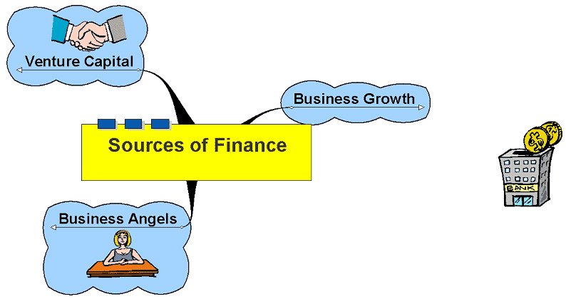
Sources of Finance

Slide 8
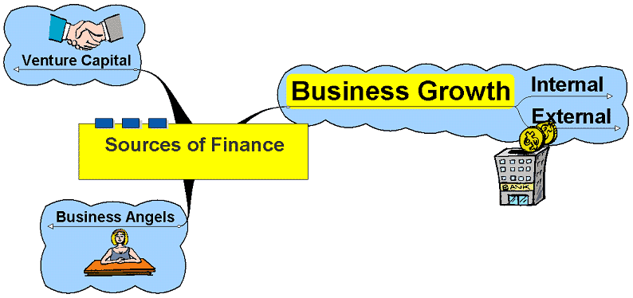
Business Growth

Slide 9

Internal Sources of Finance and Growth
‘Organic growth’ – growth generated through the development and expansion of the business itself. Can be achieved through:
Generating increasing sales – increasing revenue to impact on overall profit levels
Use of retained profit – used to reinvest in the business
Sale of assets – can be a double edged sword – reduces capacity?
Selling more goods and services to consumers is one way to grow the business.

Slide 10
Business Growth
External
Long Term
Short Term
'Inorganic Growth‘

Slide 11
Business Growth
External
Long Term
  Shares
    Ordinary Shares
    Preference Shares
    New share issues
    Rights Issue
    Bonus or Scrip Issue
  Loans
    Debentures
    Bank loans (mortgage)
    Merchant or Investment Banks
    Government/EU
      Grants

Slide 12
Business Growth
External
Short Term
  Bank loans
  Overdraft facilities
  Trade credit
  Factoring
  Invoice discounting
  Leasing

Slide 13
Business Growth
External
Short Term
Factoring is a financial transaction whereby a business sells its accounts receivable (i.e., invoices) to a third party (called a factor) at a discount in exchange for immediate money
Factoring allows company to raise finance based on the value of your outstanding invoices.
Factoring also gives company the opportunity to outsource your sales ledger operations and to use more sophisticated credit rating systems.
Company pays factoring fees

Slide 14
Business Growth
External
Short Term
LEASING is a contract between the leasing company, the lessor, and the customer (the lessee). The leasing company buys and owns the asset that the lessee requires. The customer hires the asset from the leasing company and pays rental over a pre-determined period for the use of the asset. There are two types of leases:
1: Finance Leases
An agreement where the lessor receives lease payments to cover its ownership costs. The lessee is responsible for maintenance, insurance, and taxes. Some finance leases are conditional sales or hire purchase agreements.
2: Operating Leases
The lease will not run for the full life of the asset and the lessee will not be liable for its full value. The lessor or the original manufacturer or supplier will assume the residual risk. This type of lease is normally only used when the asset has a probable resale value, for instance, aircraft or vehicles.

Slide 15
Business Growth
External
'Inorganic Growth'
  Acquisitions
    Merger
    Takeover

Slide 16

External Sources of Finance
Long Term – may be paid back after many years or not at all!
Short Term – used to cover fluctuations in cash flow
‘Inorganic Growth’ – growth generated by acquisition
The existence of capital markets enable firms to raise long term loans and share capital.

Slide 17
Long term (Means?)
Loans (Represent creditors to the company – not owners)
  Bank loans and mortgages – suitable for small to medium sized firms where property or some other asset acts as security for the loan
    A mortgage loan is a loan secured by real property
  Merchant or Investment Banks – act on behalf of clients to organise and underwrite raising finance
  Government/EU – may offer loans in certain circumstances
    Grants
Shares (Shareholders are part owners of a company only in PLC’s)
  New Share Issues – arranged by investment banks.

Slide 18
Short Term
Bank loans – necessity of paying interest on the payment, repayment periods from 1 year upwards but generally no longer than 5 or 10 years at most
Overdraft facilities – the right to be able to withdraw funds you do not currently have
  Provides flexibility for a firm
  Interest only paid on the amount overdrawn
  Overdraft limit – the maximum amount allowed to be drawn - the firm does not have to use all of this limit
Trade credit – Careful management of trade credit can help ease cash flow – usually between 28 and 90 days to pay
Factoring – the sale of debt to a specialist firm who secures payment and charges a commission for the service.
Leasing – provides the opportunity to secure the use of capital without ownership – effectively a hire agreement

Slide 19
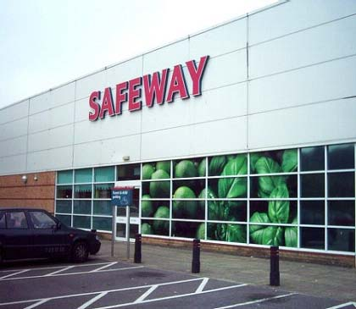
'Inorganic Growth'
Acquisitions
The necessity of financing external inorganic growth
  Merger:
    firms agree to join together – both may retain some form of identity
  Takeover:
    One firm secures control of the other, the firm taken over may lose its identity
Safeway – subject to a £3 billion takeover by Morrisons. Securing the £3 billion necessary is a specialist job.

Slide 20
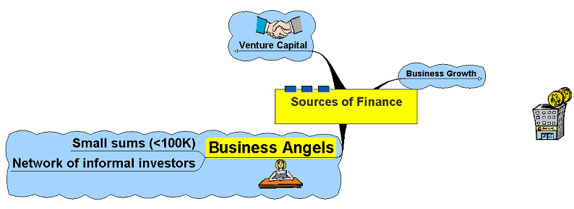
Business Angels

Slide 21
Business Angels
Individuals looking for investment opportunities
Generally small sums up to €100,000
Could be an individual or a small group
Generally have some say in the running of the company

Slide 22
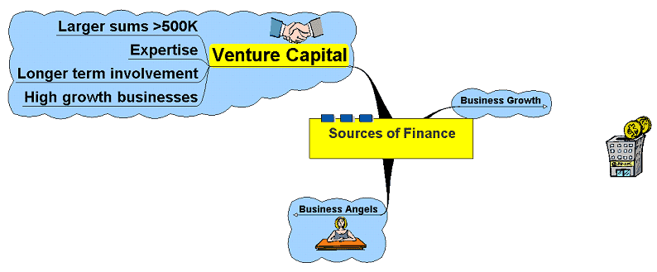
Venture Capital

Slide 23
Venture Capital
Pooling of capital in the form of limited companies – Venture Capital Companies
Looking for investment opportunities in fast growing businesses or businesses with highly rated prospects
May also buy out firms in administration who are going concerns
May also provide advice, contacts and experience

